Slide 1

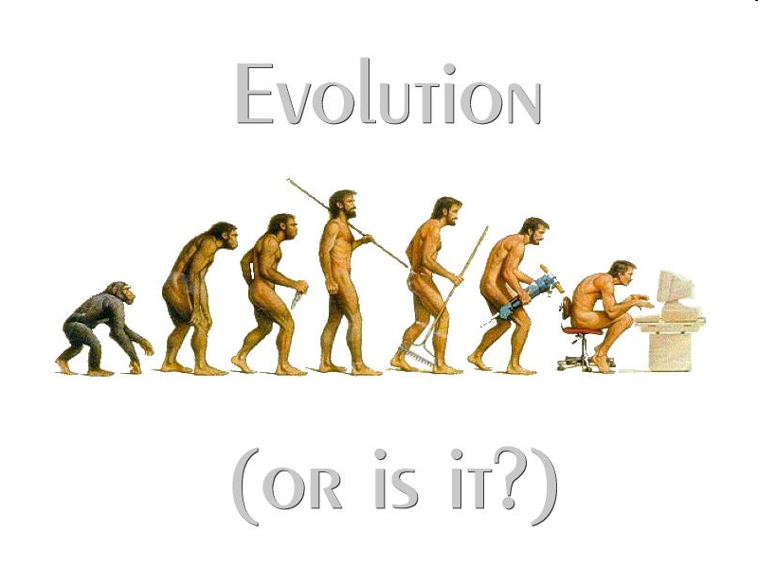

Introduction to Computer Science: Course Overview
Introduction to Computer Science
Reichman University
Lecture 1-1
Notes:
1

Slide 2
Course objectives
The course will give you …
Basic exposure to Computer Science
Basic programming skills
In addition, you will …
Sharpen your analytic skills
Appreciate clarity and elegance
Develop a taste for beauty in science and engineering
Learn how to learn and develop.
Notes:
2

Slide 3
Course requirements
Attend:
Two weekly lectures (שיעור)
One weekly recitation (תרגיל)
One weekly workshop (סדנה)
Submit:
A weekly homework assignment (שיעורי בית)
Notes:
3

Slide 4
Course Website (“Moodle”)
Contents:
Lecture slides + code
HW documents + code
Course announcements
HW submission / grades
Important:
The only formal and abiding channel of communications between the course team and the students is the course web site
What is said orally by the course staff about HW, exams, requirements, grading, deadlines – is tentative. What is written in the web site is formal.
Notes:
4

Slide 5
Q&A Forums
How to ask questions
Find the relevant forum, by week
Read existing posts (questions, answers)
If needed, post a question
You’ll get an answer within a few hours, from a TA or from another student
Feel free to answer questions, if you think that your answer will be useful
Avoid clutter, keep the channel clean
Use English (whatever is your language level – let’s practice!)
Notes:
5

Slide 6
Individual work
Read the course honor code
Notes:
6

Slide 7

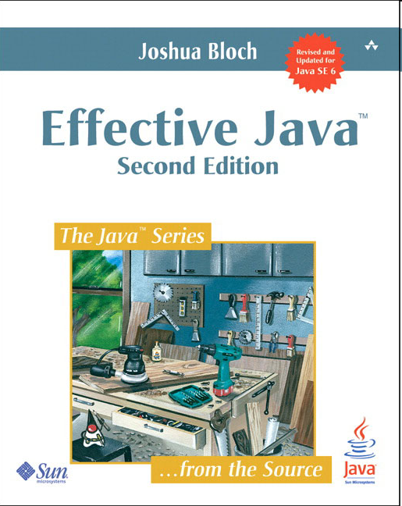
Textbooks
Introduction to Programming in Java:
an Interdisciplinary Approach
Robert Sedgwick Kevin Wayne
Recommended textbook
(any edition is fine)
For students with Java experience
(a classic)

Slide 8
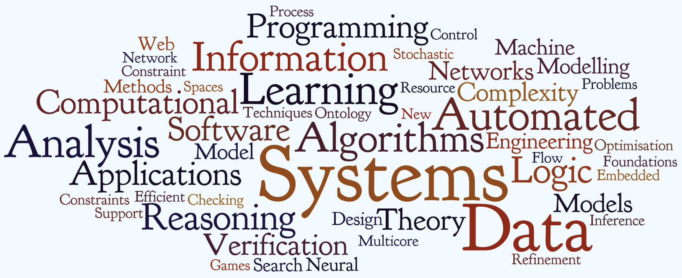

Computer science is about …
Nand

Slide 9
Computer science is about …
Theory
Algorithms
Data structures
Complexity
. . .
Systems
Operating Systems
Compilers
Networks
. . .
Applications
Image processing
Molecular biology
Artificial intelligence
. . .
Common themes
Programming
Efficiency
Beauty (acquired taste)

Slide 10

A taste of programming
Simulate the motion of N heavenly bodies, subject to Newton’s laws of motion and gravity

Slide 11
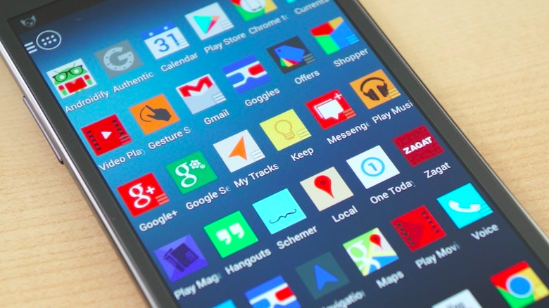
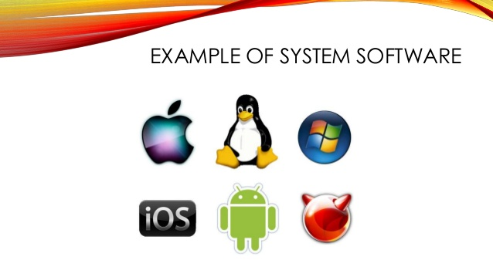
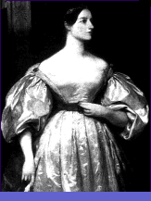

Programming is about . . .
Problem solving
Imaging, simulation, medical systems, e-commerce, social networks, chatbots, ...
Packaged software
Apps, games, tools, ...
System software
Operating systems, compilers, networks, cloud, security, ...
Can programming help solve any possible problem / need?
No, computers and programming have inherent limitations
Stay tuned.
Ada Lovelace
Alan Turing

Slide 12
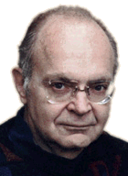
Programming is about . . .
Writing code that is:
Correct
Efficient
“Instead of imagining that our main task as programmers is to instruct a computer what to do, let us concentrate rather on explaining to human beings what we want a computer to do.” – Donald Knuth
And is:
Easy to test
Easy to understand
Easy to maintain
Easy to extend
Pleasure to work with
Notes:
12

Slide 13
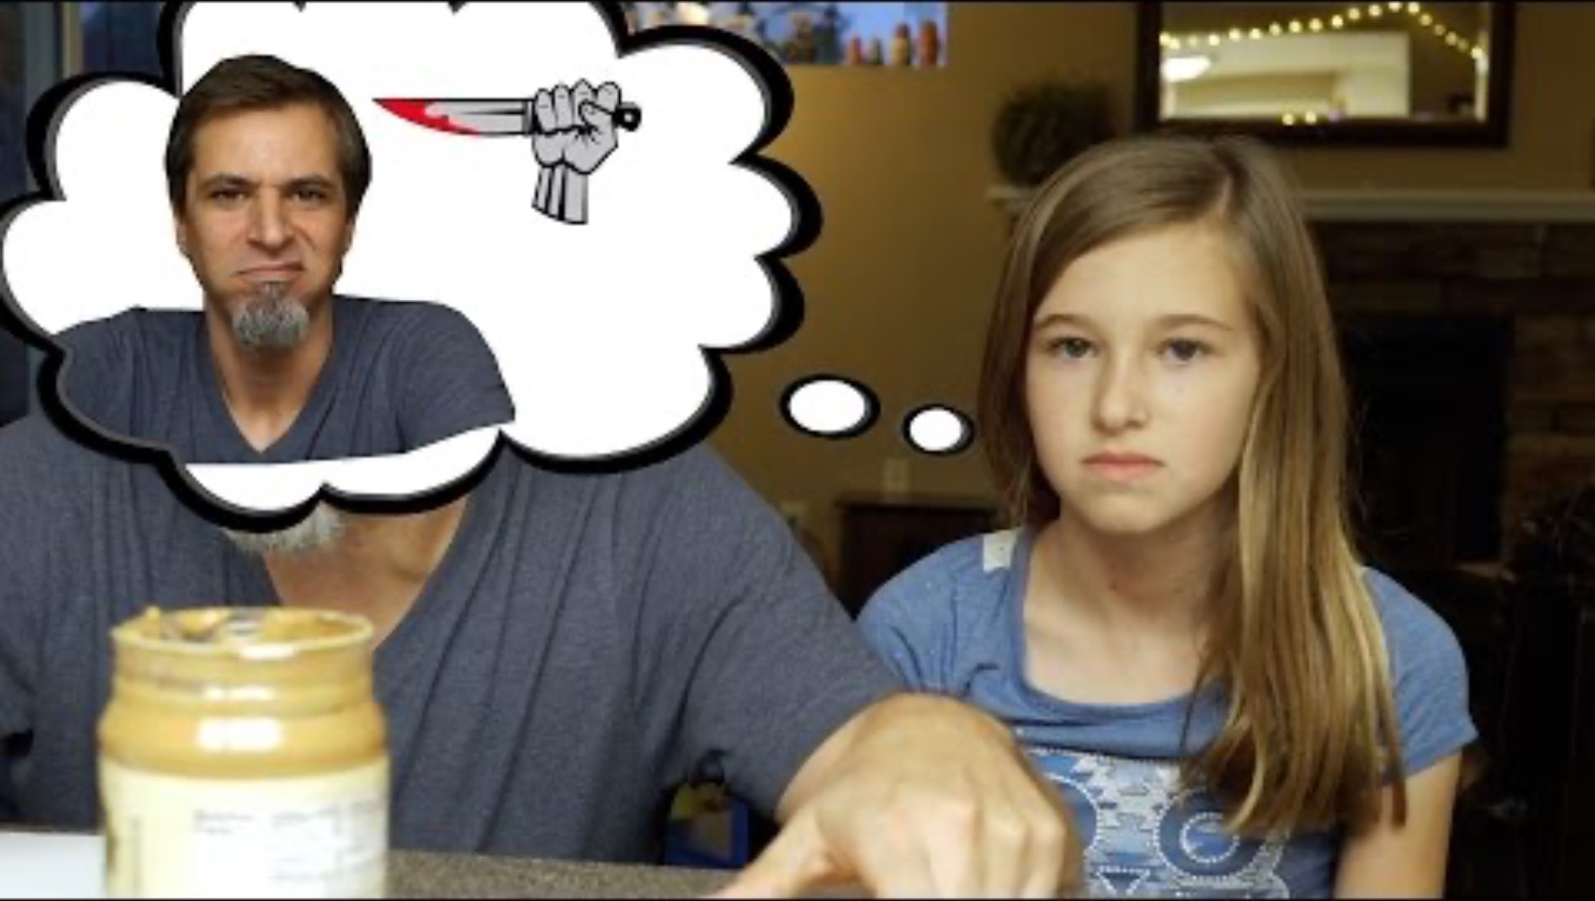
Programming is about . . .
Writing code that is:
Correct
Efficient
“Instead of imagining that our main task as programmers is to instruct a computer what to do, let us concentrate rather on explaining to human beings what we want a computer to do.” – Donald Knuth
And is:
Easy to test
Easy to understand
Easy to maintain
Easy to extend
Pleasure to work with
How to make a peanut butter sandwich...
Notes:
13

Slide 14
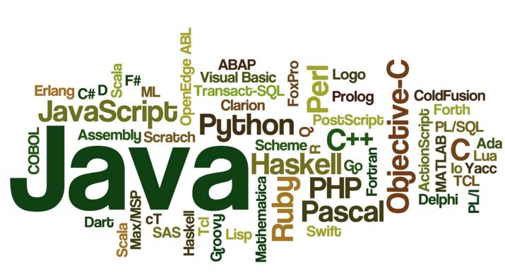
Programming languages
Which language to learn?
Java
Python
C
Haskell
. . .

Slide 15
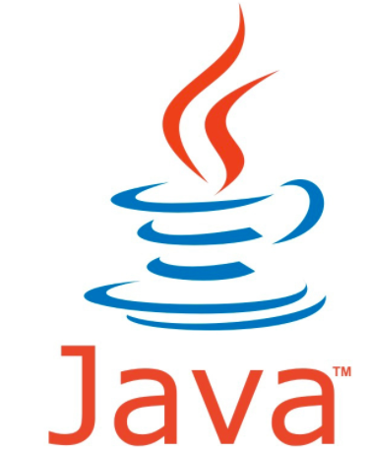
Programming languages
Why Java?
Widely used
Widely available
Powerful, elegant, multi-platform
Addresses numerous needs
Excellent software development tools
Our school legacy
Java Applications
Android
Google docs
Netflix
Spotify
LinkedIn
Amazon
. . .

Slide 16
Programming languages
Facts of life
There is no perfect programming language
We need to choose some language
Our approach
Teach a subset of Java
Develop general programming skills applicable to any software development task
Build a foundation that allows learning any other language quickly
It’s not about the language!
“There are two kinds of programming languages: those that people always complain about, and those that nobody uses.”
– Bjarne Stroustrup (father of C++)

Slide 17
Java program example
Task: Print the numbers 0 to 5
Algorithm
Java implementation
i = 0
while (i < 6)
print i
i = i + 1
public class Demo0 {
public static void main(String[] args) {
// Declares an integer variable and sets it to 0
int i = 0;
while (i < 6) {
// Prints i, and increments it
System.out.println(i);
i = i + 1;
}
System.out.println("Done");
}
}
Pseudocode
Java code

Slide 18
Java syntax elements (first approximation)
“Words”:
reserved words
identifiers (user-defined)
reserved words
public class Demo0 {
public static void main(String[] args) {
// Declares an integer variable and sets it to 0
int i = 0;
while (i < 6) {
// Prints i, and increments it
System.out.println(i);
i = i + 1;
}
System.out.println("Done");
}
}

Slide 19
Java syntax elements (first approximation)
Java reserved words:
abstract continue for new switch
assert default goto package synchronized
boolean do if private this
break double implements protected throw
byte else import public throws
case enum instanceof return transient
catch extends int short try
char final interface static void
class finally long strict volatile
const float native super while

Slide 20
Java syntax elements (first approximation)
“Words”:
reserved words
identifiers (user-defined)
identifier
public class Demo0 {
public static void main(String[] args) {
// Declares an integer variable and sets it to 0
int i = 0;
while (i < 6) {
// Prints i, and increments it
System.out.println(i);
i = i + 1;
}
System.out.println("Done");
}
}
identifier

Slide 21
Java syntax elements (first approximation)
“Words”:
reserved words
identifiers (user-defined)
public class Demo0 {
public static void main(String[] args) {
// Declares an integer variable and sets it to 0
int i = 0;
while (i < 6) {
// Prints i, and increments it
System.out.println(i);
i = i + 1;
}
System.out.println("Done");
}
}
Literals (constants):
numbers
strings
numeric literals (like 0, 6)
String literal

Slide 22
Java syntax elements (first approximation)
“Words”:
reserved words
identifiers (user-defined)
public class Demo0 {
public static void main(String[] args) {
// Declares an integer variable and sets it to 0
int i = 0;
while (i < 6) {
// Prints i, and increments it
System.out.println(i);
i = i + 1;
}
System.out.println("Done");
}
}
Literals (constants):
numbers
strings
Symbols:
( ) [ ] { } , . ; + - * / ...
symbol

Slide 23
Java syntax elements (first approximation)
“Words”:
reserved words
identifiers (user-defined)
public class Demo0 {
public static void main(String[] args) {
// Declares an integer variable and sets it to 0
int i = 0;
while (i < 6) {
// Prints i, and increments it
System.out.println(i);
i = i + 1;
}
System.out.println("Done");
}
}
Literals (constants):
numbers
strings
comment
Symbols:
( ) [ ] { } , . ; + - * / ...
White space
comments
indentation
colors.
Best practice note (about the comments in this program):
First comment: Not necessary
Second comment: Useful, although the code is self-explanatory

Slide 24
Java program structure
public class Demo0 {
public static void main(String[] args) {
// Declares an integer variable and sets it to 0
int i = 0;
while (i < 6) {
// Prints i, and increments it
System.out.println(i);
i = i + 1;
}
System.out.println("Done");
}
}
Program (loosely defined): a collection of one or more classes
Class: a collection of one or more methods / functions
Method / function: a sequence of one or more statements
method, function
class
In this course:
We’ll start writing programs that consist of one class and one method (“main”)
Later we will write classes that consist of several methods
Later we will write programs that consist of several classes.

Slide 25
Java program structure
public class Demo0 {
public static void main(String[] args) {
// Declares an integer variable and sets it to 0
int i = 0;
while (i < 6) {
// Prints i, and increments it
System.out.println(i);
i = i + 1;
}
System.out.println("Done");
}
}
White space Comments, indentation, colors (ignored by the compiler)
Purpose Used to make programs readable
Program readability and clarity are as important as program correctness (maybe more)!
Same functionality
public class Demo0 {public static void main(String[] args){int i=0;while (i<6){System.out.println(i);i=i+1;}System.out.println("Done");}}
“Any fool can write code that a computer understands.
Good programmers write code that humans understand” – Martin Fowler

Slide 26
Java program structure
public class Demo0 {
public static void main(String[] args) {
// Declares an integer variable and sets it to 0
int i = 0;
while (i < 6) {
// Prints i, and increments it
System.out.println(i);
i = i + 1;
}
System.out.println("Done");
}
}
Aspects of any language
Semantics (what you want to say / do): meaning / intention
Syntax (how to say it): The rules of the language: vocabulary and grammar
Style (how well you say it): Critically important
Natural languages (Hebrew, English, ...)
Allow breaking syntax rules
Occasionally there is more than one meaning to a sentence
Programming languages
Syntax is sacred
Only one semantic interpretation: No ambiguity

Slide 27


Program development
edit
MyProg.java
Java source file
javac
Java compiler
MyProg.class
Bytecode file
debugging process
java
Java run-time
happy with results?
Yes
No

Slide 28
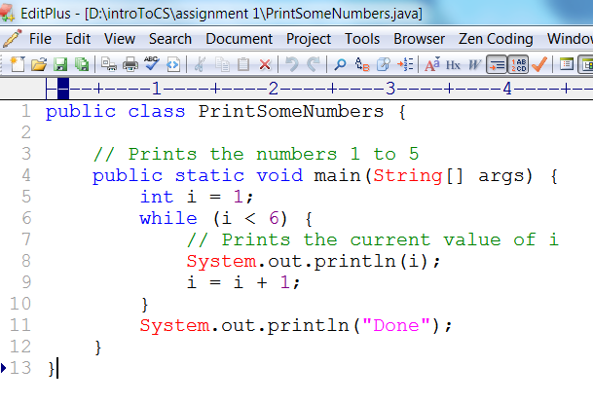
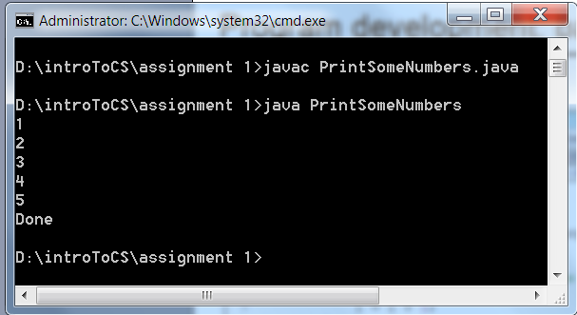
Program development: “Command” / “Terminal” level
Edit (in this example: the file Demo0.java):
Compile and execute:
Debugging
0. Run / execute the program
1. Observe the program’s execution
2. Figure out what’s wrong
3. Use the editor to fix the code
4. Goto step 0.

Slide 29
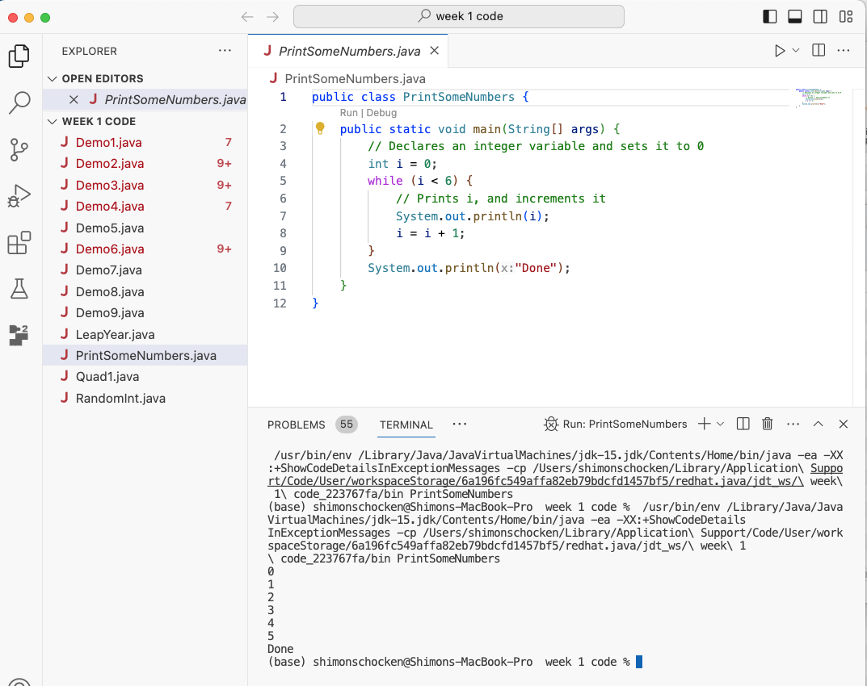
Program development: Integrated Development Environments
IDE: a software package featuring:
editor (language-specific)
compiler
debugger
. . .
various dev goodies
compile / run
Popular IDEs:
VS Code
InteliJ
Eclipse
NetBeans
. . .
editor
Files
terminal

Slide 30


Debugging
That’s what you’ll do most of the semester
Error types
Compile-time errors: mostly syntax violations; detected by the compiler
Run-time errors: the program passes compilation, runs, but crashes
Logical errors:
The program runs, doing something unexpected
The program runs, but should be improved
Mistakes are the portal of discovery
(James Joyce)
Anything that can possibly go wrong, will
(Murphy’s Law)

Slide 31
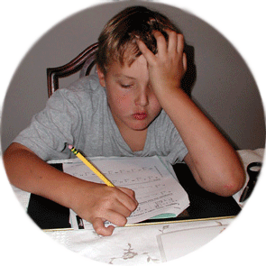
Things to do
Getting started
Visit the course website
Install Java + VS Code on your computer (Safe Landing Tutorial)
Homework 1
Play with an existing Java program
Experience debugging
Write a few simple programs
Further instructions: see the course website.

